Slide 1
DOCUMENT LAYOUT ANALYSIS
University Of Karachi
Department Of Computer Science
Group Members:
Sania Irfan | B12101110 | saniairfan4@gmail.com
Tooba Aziz | B12101134 | toobi_94@hotmail.com
Course Supervisor: Dr. Humera Tariq

Slide 2
Contents
Problem Statement
Why It is important to Solve the Chosen Problem?
Data Acquisition (Input Images)
Block Diagram
GUI
intermediate and output images (Important Results)
Preprocessing Details
Algorithm Description
Image Segmentation
Feature Extraction
Matching Criteria
Challenges/ Difficulties
Learning and Achievements
Improvements and Future Work
Demo and Queries

Slide 3
Problem Statement
The process of document structure and layout analysis tries to decompose a given document image into its component regions and understand their functional roles and relationships.
The process of Document Layout Analysis aims to decompose a document image into a hierarchy of homogenous regions, such as figures, background, text blocks, text lines, words, characters, etc.
We assign functional or logical labels to some of these regions.

Slide 4
Importance
To Solve the given Problem is important because automatic analysis of an arbitrary document with complex layout is an extremely difficult task and is beyond the capabilities of layout analysis systems these days. This is interesting since documents are designed to be effective and clear to human interpretation.

Slide 5
Data Acquisition
In this section we describe that how we acquire input images / Video for processing. Input Images are also shown to understand the addressed Problem.

Slide 6
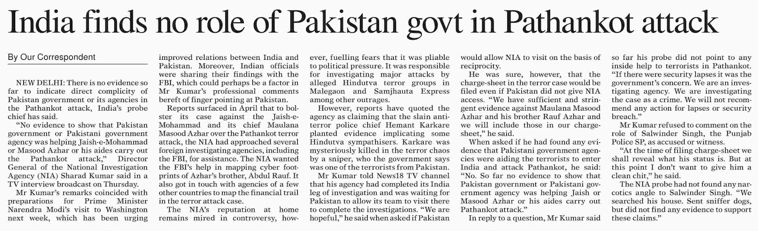
Newspaper images are a good way to start document structure analysis. We gathered the images from epaper.dawn.com.

Slide 7
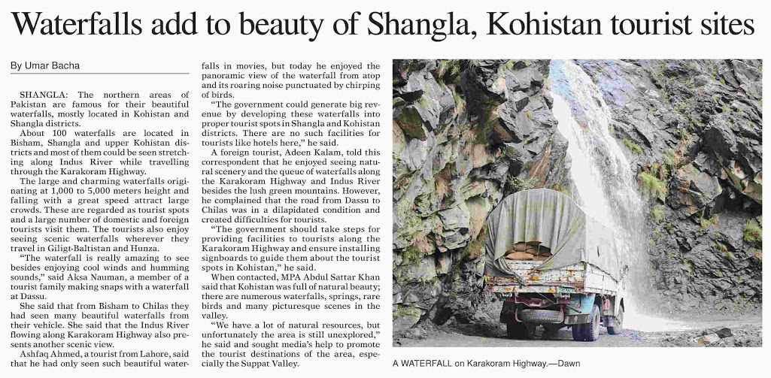

Slide 8
Block Diagram/Flow of Work
In this Section we described with the help of Block Diagram, the principles we studied and apply to input images to address the mentioned problem.

Slide 9
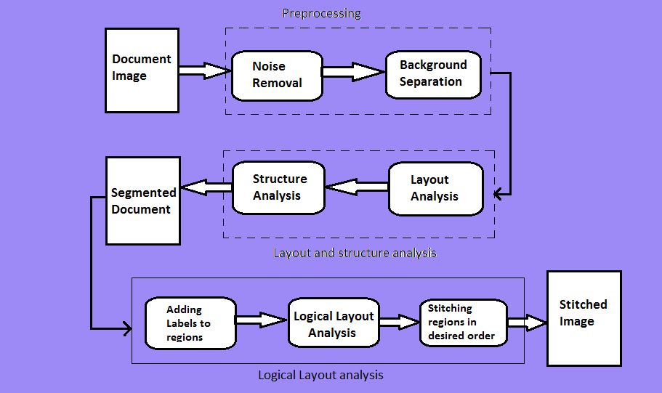

Slide 10
GUI
In this section we show our GUI so that viewers can understand the interaction in between input and output.

Slide 11
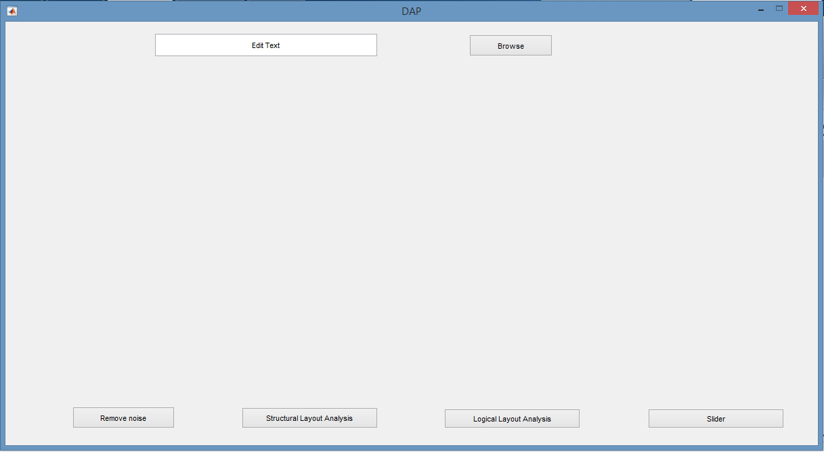
It’s a simple GUI in which user have to browse the image for the processing. Results will be shown in the empty space in between.

Slide 12
Results
Before getting into the theoretical/Mathematical details we will show viewers some important results to grasp the techniques and concepts.

Slide 13
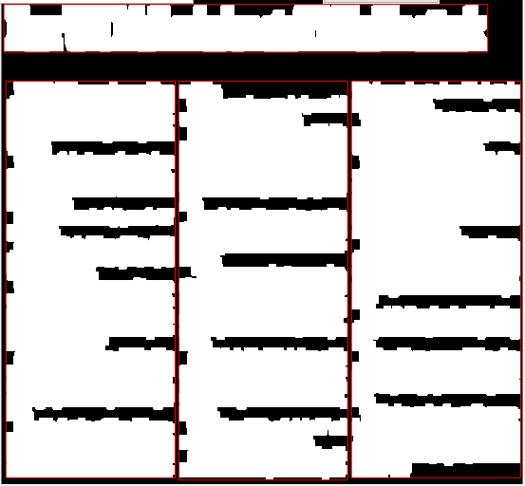
Dilation (Structural layout)

Slide 14
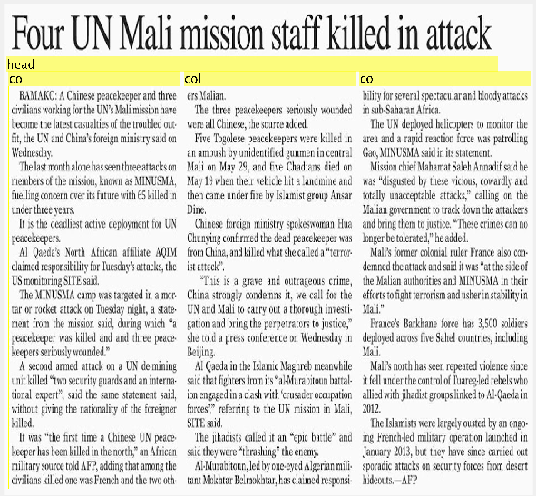
Labelling (Logical Layout)

Slide 15
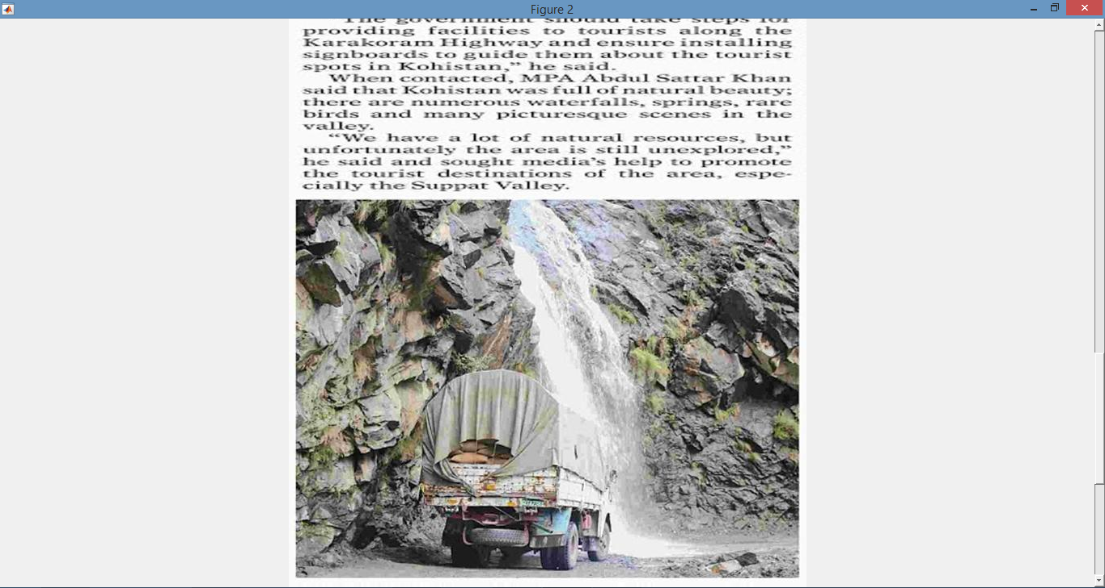
Concatenation of cropped images

Slide 16
Preprocessing
In this Section we described the preprocessing applied on input images along with necessary matlab code.

Slide 17
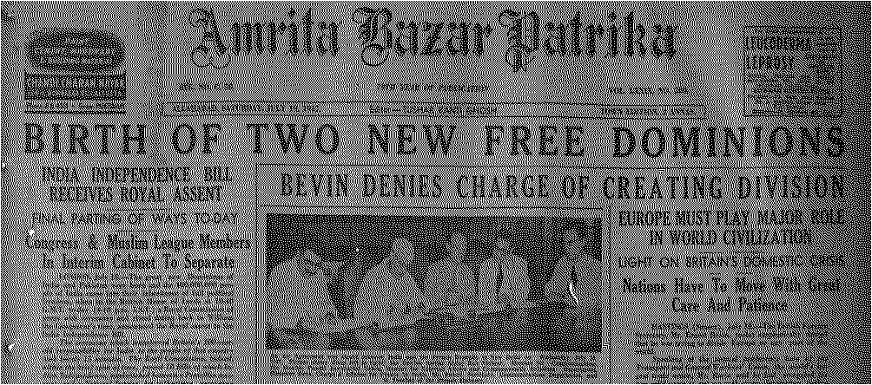
Noise Removal (Halftone)

Slide 18
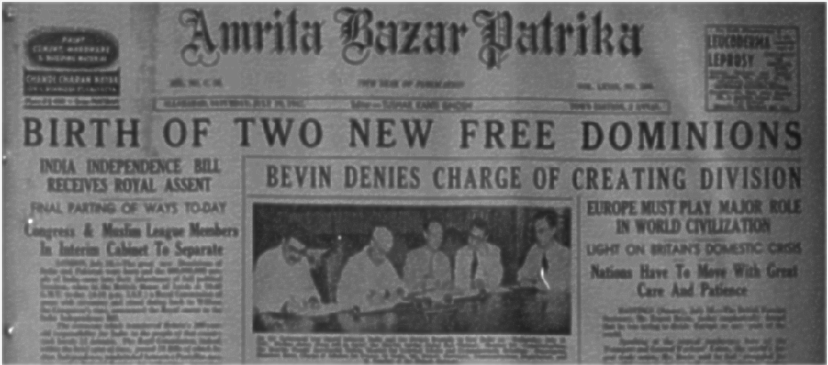
After applying median filter.

Slide 19
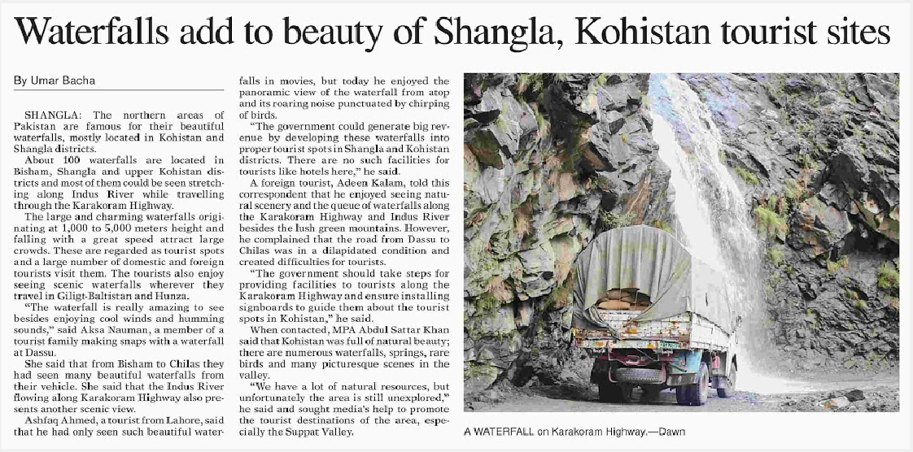
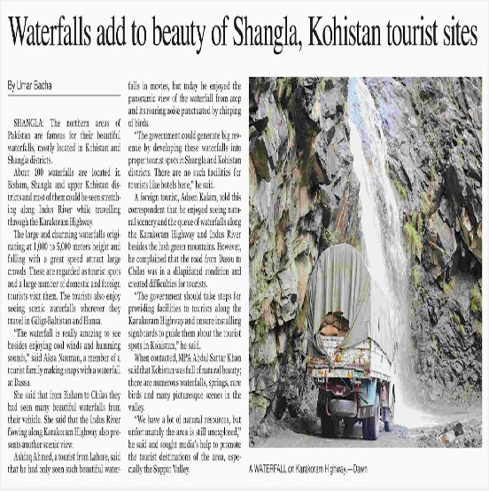
Aspect ratio
Original image
After applying aspect ratio

Slide 20
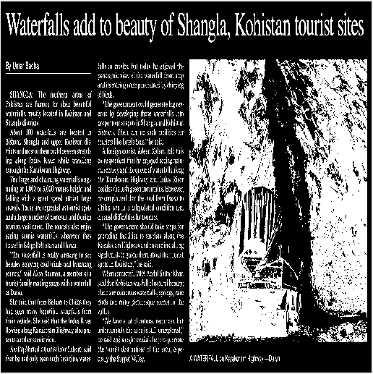
Foreground detection
Threshold the image using graythresh function.

Slide 21
Algorithm Description
Here we describes the key steps of algorithm that we used for image segmentation and/Or Feature Extraction

Slide 22
Approach: Top-down
Region segmentation: regionprops(‘BoundingBox’).
Region classification: Text vs Image using OCR-based approach.
Algorithm: X-Y cut (imcrop())
Concatenation of images: cat(cell{ })

Slide 23
Step 1:
Background separation was done by thresholding and inverting the image.
Step 2:
Structural layout analysis is done by morphological operations.
Step 3:
Logical layout analysis is done by adding labels to the segmented image regions.
Textual and non-textual regions are separated by OCR.
Step 4:
Image stitching is then performed on the segments formed in the previous steps and are placed together vertically with a scrollbar on it.

Slide 24
Challenges and difficulties

Slide 25


Single Dilation applied in image doesn’t work in all images. Especially the head part always need some extra dilation so that it make an unbreakable rectangle.
Solution:
We cropped out the upper portion in which head lies and applied a different structuring element. Put back the cropped part back in its position.

Slide 26
2. To make almost all images of same size.
Solution:
We used the aspect ratio property.
Here the width is fixed and according to that new height is calculated.
%Aspect Ratio
R=w/h;
newh=h*R;
img=imresize(img1,[newh 3075]);

Slide 27
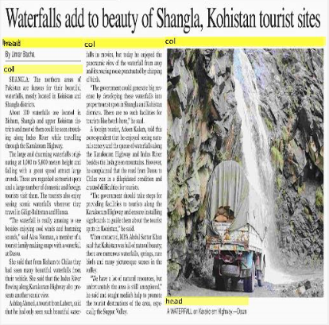

3. To classify between column vs image.
Solution:
We used OCR to distinguish between textual and non textual region.

Slide 28
Learning and Achievements
In this section we describe the things that makes us feel that we have learned, we did something new , we did something that is different and thus we should get full marks or even we deserves Bonus marks.

Slide 29
We tried to build a document understanding system , something we never heard and thought of before this course.
We have learned the basics of physical and logical layout of a newspaper.
We can crop the region of interest and put it back in their original position after applying some processing in order to work partially on that image.
Also, we can reduce the time of processing by making it efficient.
How to deal with different types of images.
Learned to code on MATLAB.

Slide 30
Improvements and future work
In this section we mention the tasks that are still unresolved. The exceptional cases where still improvement is needed. We also mention the applications that can build on top of our current work.

Slide 31
Improvement
There is need of tuning limits of bounding box for further sub divisions like sub-heading, line, word etc.
Also, a more efficient approach could be applied for concatenation of images so that the cropped images of different size would not matter in the future.

Slide 32
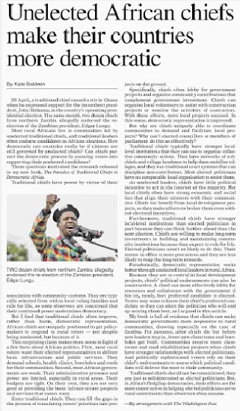
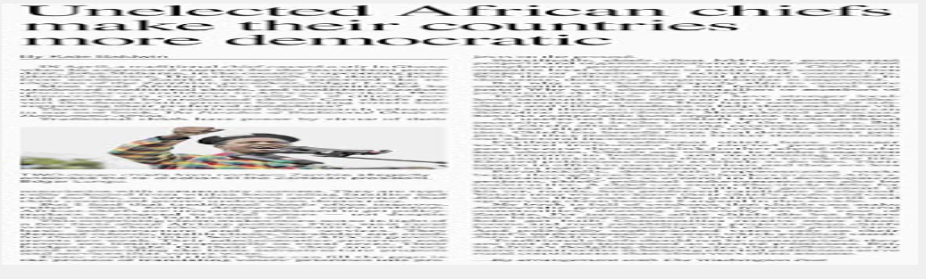

Images with small width can’t have a proper dilation, they merge into each other.

Slide 33
References
https://cvit.iiit.ac.in/papers/DocStructure.pdf
http://www.mathworks.com/
http://stackoverflow.com/

Slide 34
Demo and Queries

